Slide 1

Trust Region Policy Optimization
24.08.16
Kangyeon Kim

Slide 2


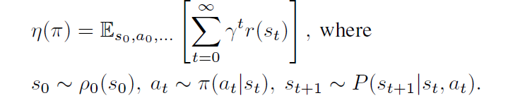
1. Preliminaries
(1) infinite-horizon discounted MDP
reward
initial state distribution
expected discounted cost:

Slide 3
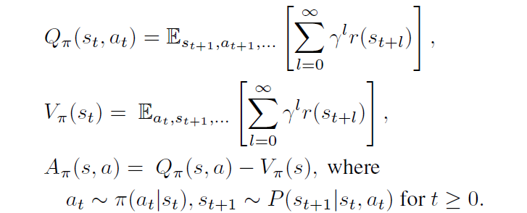
1. Preliminaries
(1) infinite-horizon discounted MDP
action value function, value function, and the advantage function:

Slide 4

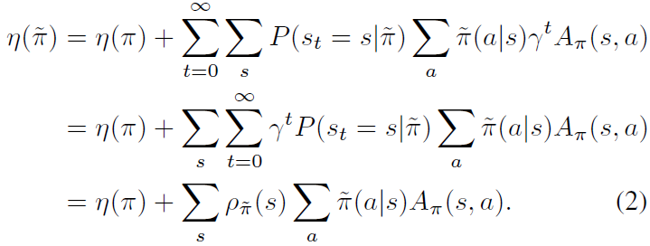
1. Preliminaries
(1) infinite-horizon discounted MDP
expected return of another policy :
discounted visitation frequencies:
Rewrite eq (1):
difficult to get expectation(or sampling) from new policy
Notes:
현재 주어진 정책 π 에 대해서 우리는 η(π) 와 Aπ를 알고 있는 상황이다.
η(~π) 은 η(π) 에서 π 대신 ~π로 trajectory를 뽑았을 때 얻게 되는 이익의 기댓값을 더해준 값이다
참고로 π로 행동을 뽑았을 때 Eat∼π(at|st)[Aπ(st,at)]=인 것을 생각하면 , Eat∼~π(at|st)[Aπ(st,at)] 가 ~π를 사용했을 때 얻게 되는 추가 이득인 것을 받아들이기 쉽다.

Slide 5




1. Preliminaries
(1 continue) policy update
non-negative advantage at every state is guaranteed to increase policy performance $η$(by definition)
classic deterministic policy update

Slide 6

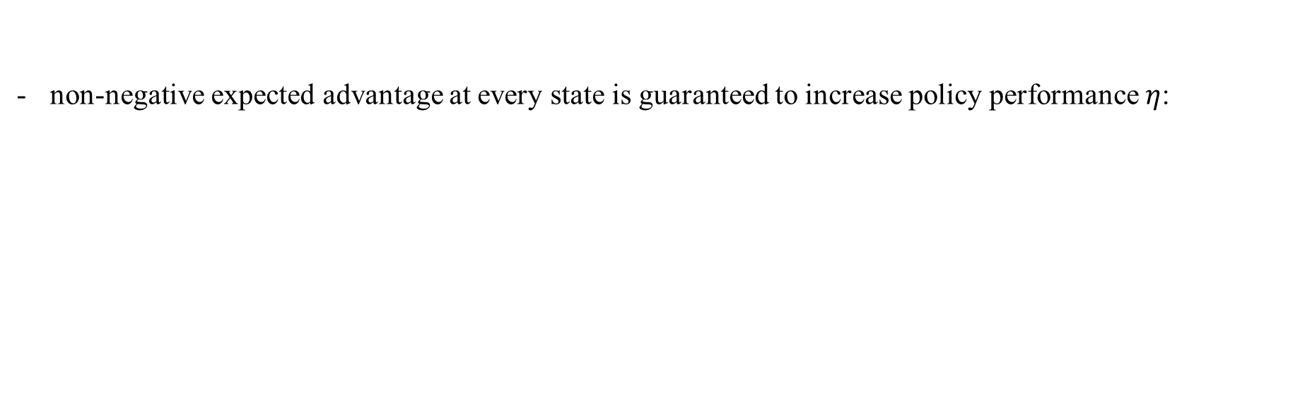
1. Preliminaries
(1 continue) policy update
non-negative expected advantage at every state is guaranteed to increase policy performance $η$:
classic deterministic policy update
estimation and approximation error
Notes:
기존 정보를 믿고 확 가는 느낌.

Slide 7

1. Preliminaries
(1 continue) policy update
hard to estimate..!
Local approximation (surrogate objective)
- ignore changes in state visitation density due to changes in the policy
Notes:
천천히 조금 가는 느낌.

Slide 8
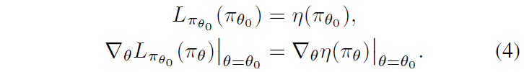
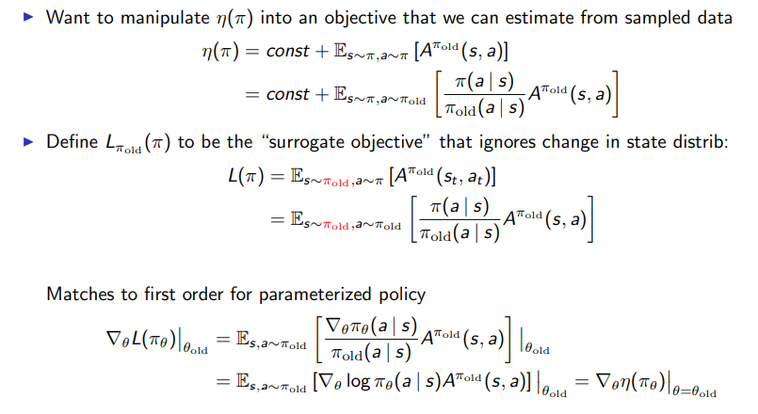

1. Preliminaries
(1 continue) policy update
If we have parameterized policy:
- Then, how can decide sufficiently small step that improve $η$ by policy update ?
(because advantage is zero)
(first order) step that improves $L_{π}$ will also improve $η$
Conservative policy iteration update
Theorem 4.1 from Approximately Optimal Approximate Reinforcement Learning

Slide 9

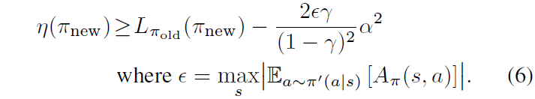
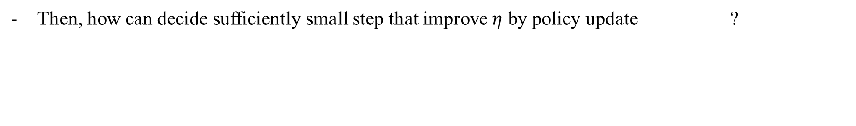
1. Preliminaries
(1 continue) policy update
Then, how can decide sufficiently small step that improve $η$ by policy update ?
Conservative policy iteration update
Notes:
Advantage 함수의 기댓값은 0이라는 것을 염두하면, π′가 πnew와 다르면 다를수록 ϵ이 커지게 된다. 따라서 π′와 πnew가 비슷하면 2ϵγ(1−γ)2α2이 0에 가까워지고, π′=πnew이면 식 (4)에서 봤던 것처럼 등호가 성립하게 된다.

Slide 10

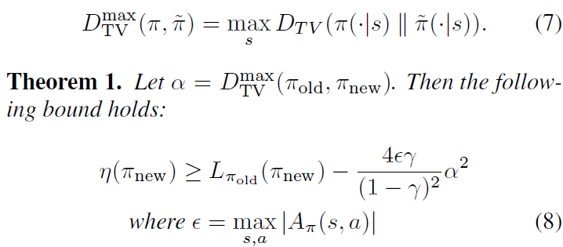
2. Monotonic Improvement Guarantee
[Theorem 1]
extend to general stochastic policies, rather than just mixture policies.
(replacing alpha with a distance measure)

Slide 11
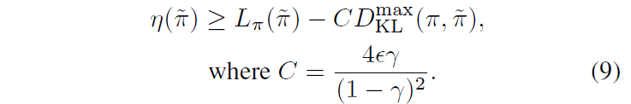
2. Monotonic Improvement Guarantee

Slide 12
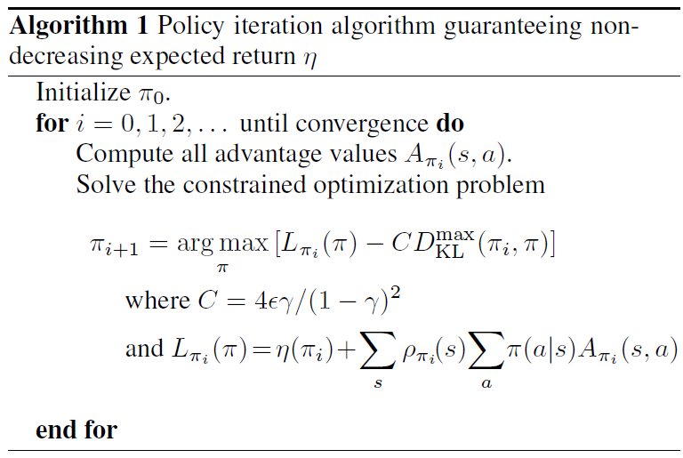
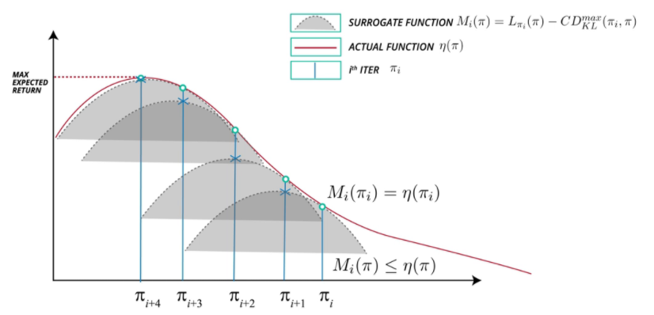
2. Monotonic Improvement Guarantee
[Algorithm 1]
* assume exact evaluation of the advantage values $A_{π}$.

Slide 13




2. Monotonic Improvement Guarantee
[Algorithm 1]
* assume exact evaluation of the advantage values $A_{π}$.

Slide 14
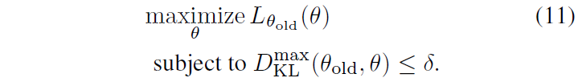
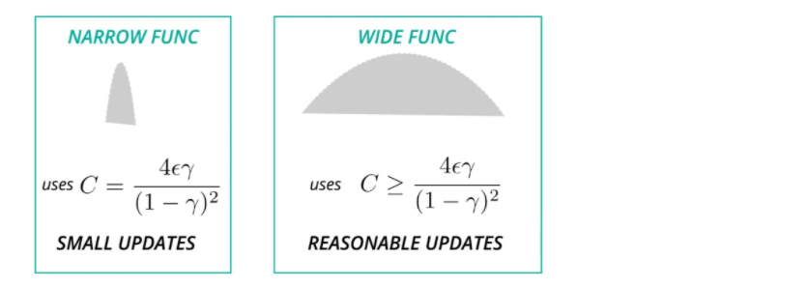
3. Optimization of Parameterized Policies
problem: very small step size due to penalty coefficient C
solution to take larger steps in a robust way: trust region constraint
(이론적으로 delta를 설정해줄 것이라고 생각했지만, 실험적으로 delta를 넣어준다고 한다..
따라서, trust region이 너무 커서 새로운 정책과 기존 정책의 distance가 크다면, optimal policy로 수렴을 보장할 수 없다.)

Slide 15
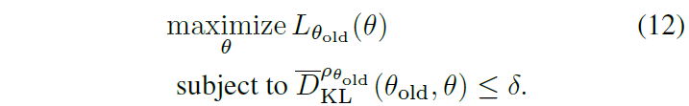
3. Optimization of Parameterized Policies
problem: very small step size due to penalty coefficient C
solution to take larger steps in a robust way: trust region constraint
problem: impractical to solve due to the large number of constraints (state space)
solution: heuristic approximation which considers the average KL divergence
Notes:
* Trust region: 적당히 큰 step size으로 eta를 안정적으로 증가시킬 수 있는 영역

Slide 16
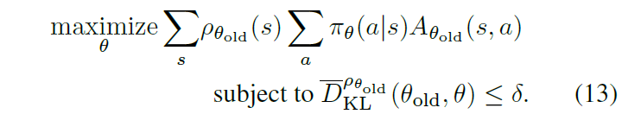
4. Sample-based estimation

Slide 17


4. Sample-based estimation

Slide 18

4. Sample-based estimation
Notes:
on-policy 알고리즘들에서 Q 함수를 추정하는 다양한 방식들이 있기 때문이다.

Slide 19

4. Sample-based estimation
Importance sampling estimator
* q denote the sampling distribution.
(can recycle the sample from old policy)

Slide 20
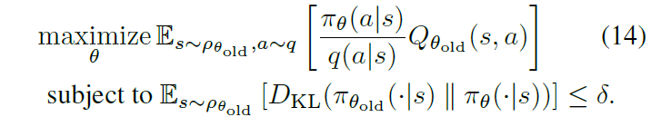
4. Sample-based estimation

Slide 21
4. Sample-based estimation
Now, we need to replace the expectations by sample averages and
replace the Q value by an empirical estimate.

Slide 22
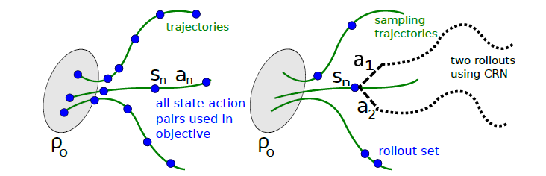

4. Sample-based estimation
[single path]
based on sampling individual trajectories.

Slide 23



4. Sample-based estimation
[vine]
constructing a rollout set and then
performing multiple actions from each state in rollout set.
‘rollout set’
sample k actions from each state.
(or any choice of distribution which can achieve better exploration)
estimate by performing a rollout.

Slide 24
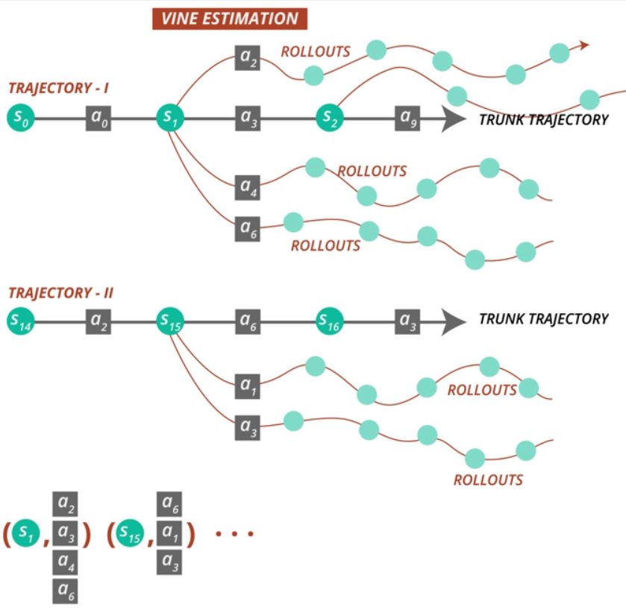
4. Sample-based estimation

Slide 25
4. Sample-based estimation
[vine]
constructing a rollout set and then
performing multiple actions from each state in rollout set.
‘rollout set’
sample k actions from each state.
(or any choice of distribution which can achieve better exploration)
estimate by performing a rollout.
[advantage]
local estimate of the objective has much lower variance given the same number of Q-value samples in the surrogate objective. (better estimates of the advantage values)

Slide 26
4. Sample-based estimation
[vine]
constructing a rollout set and then
performing multiple actions from each state in rollout set.
‘rollout set’
sample k actions from each state.
(or any choice of distribution which can achieve better exploration)
estimate by performing a rollout.
[disadvantage]
more calls to the simulator for each of these advantage estimates

Slide 27
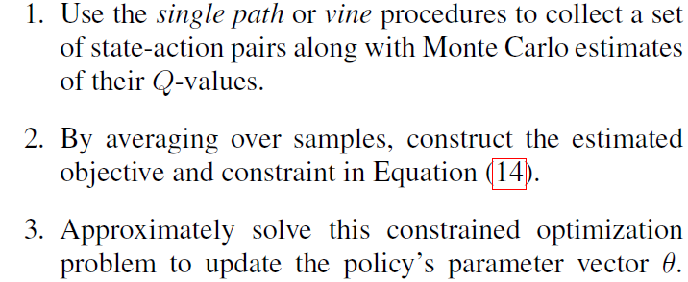
5. Practical Algorithm
* Conjugate gradient method:
결과적으로 objective는 1차근사하고 constraint는 2차근사(Hessian)하여 최적화 문제를 풀게 된다.

Slide 28
Trust Region Policy Optimization
24.08.16
Kangyeon Kim
Notes:
KL divergence: https://hyunw.kim/blog/2017/10/27/KL_divergence.html
overall 1: https://hiddenbeginner.github.io/rl/2022/09/18/trpo.html
overall 2: https://rlwithme.tistory.com/6

Slide 29
Appendix
Motivation
High variance
Delayed reward problem
Sample inefficiency
Learning rate highly affects training

Slide 30
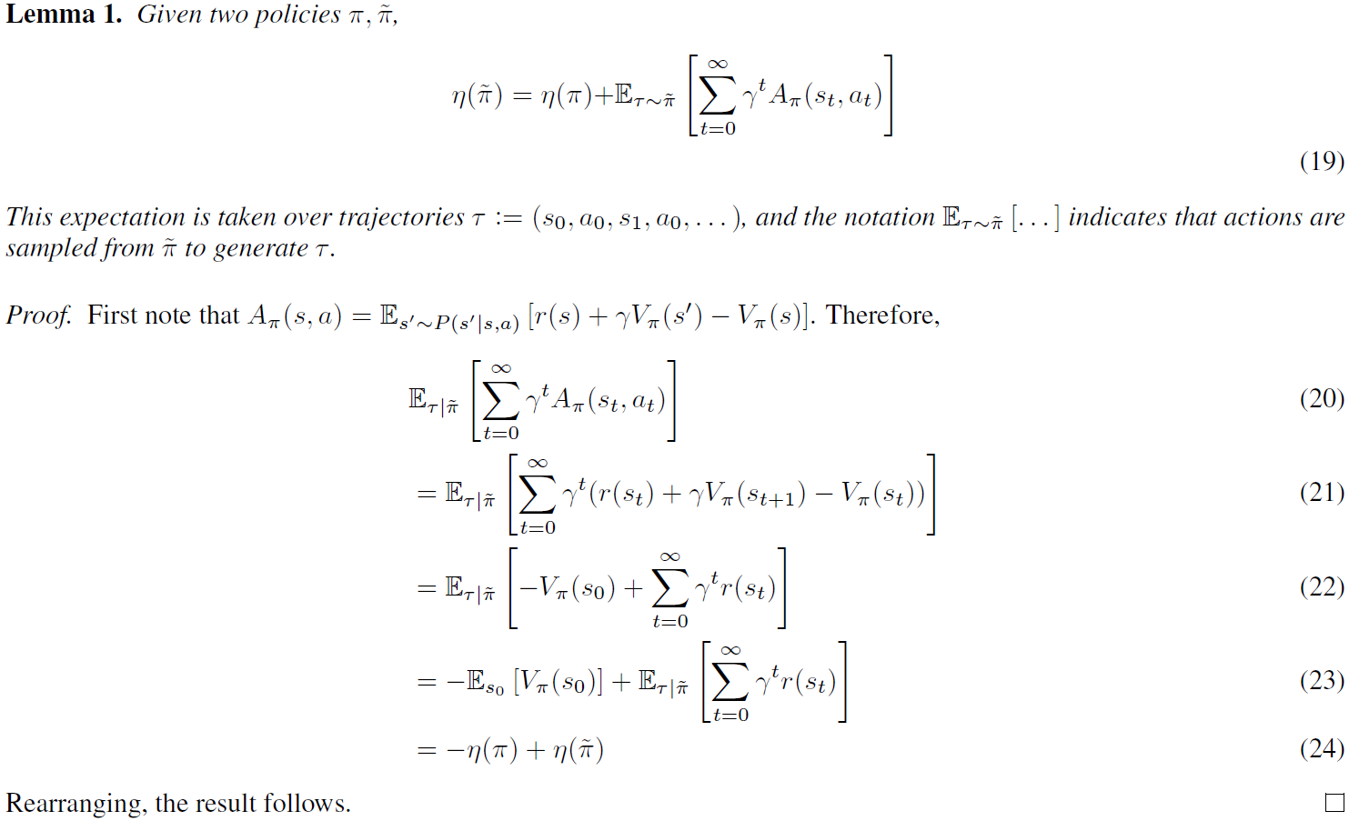
Appendix
[Proof of Lemma 1]

Slide 31
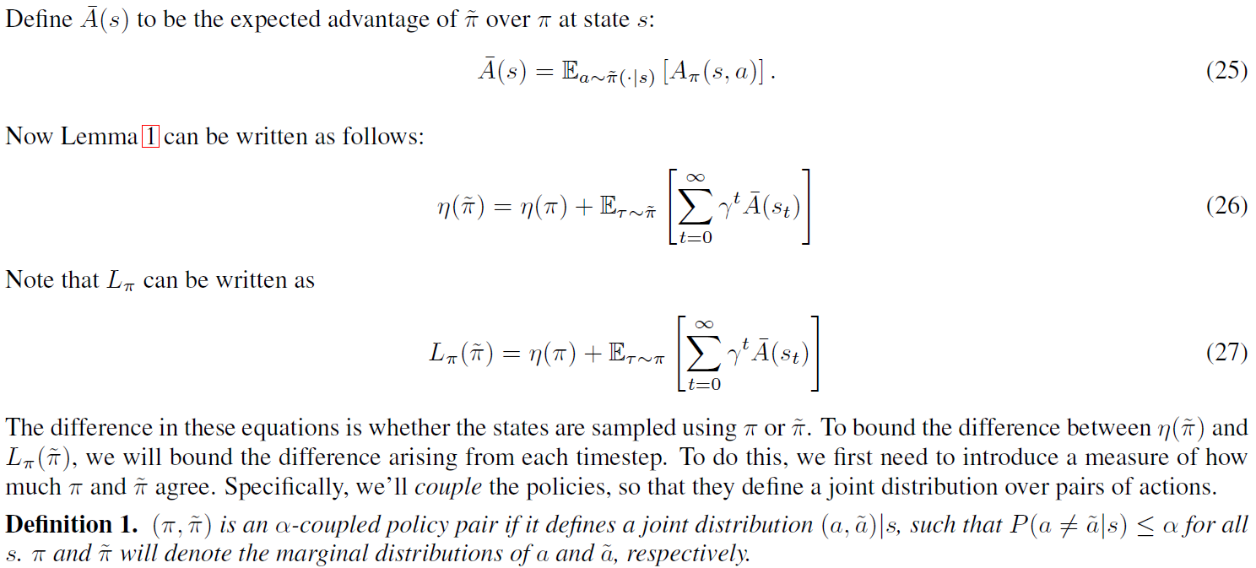
Appendix
[Proof of Theorem 1]

Slide 32
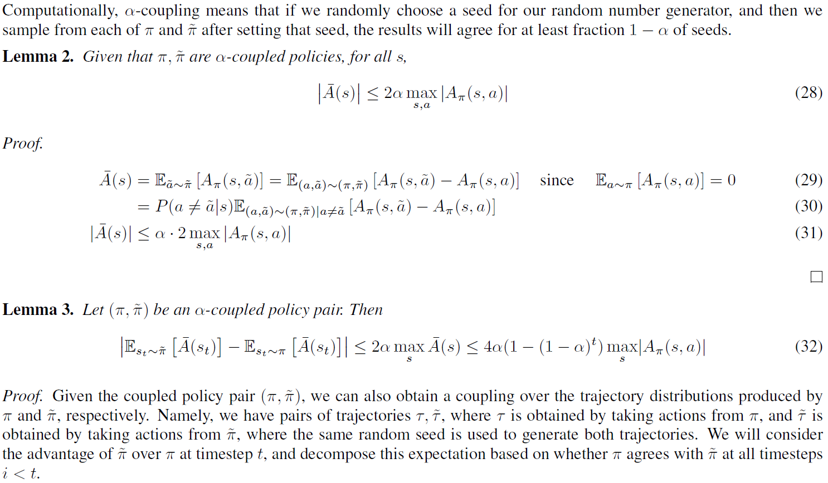
Appendix
[Proof of Theorem 1]

Slide 33
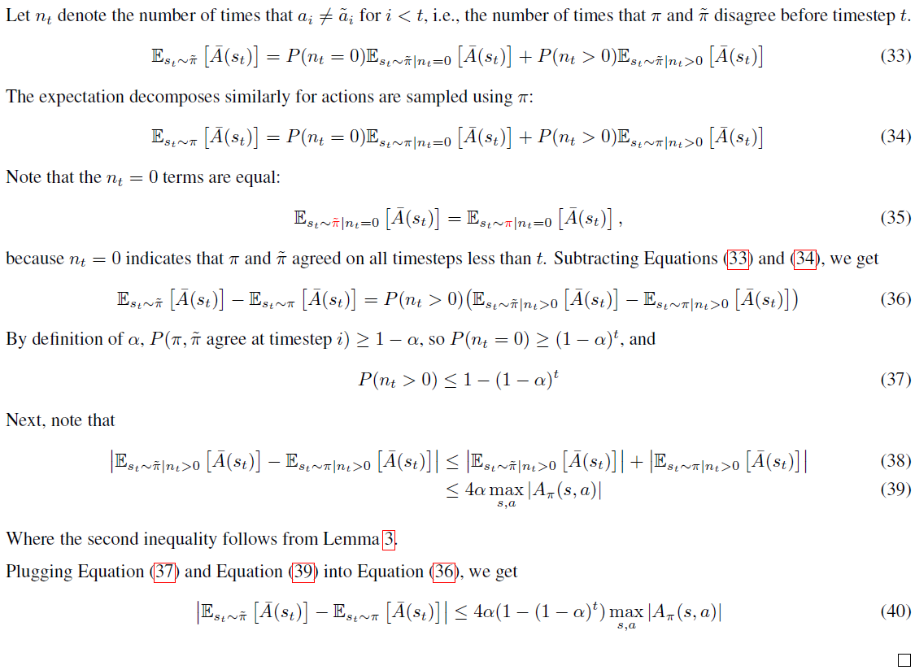
Appendix
[Proof of Theorem 1]

Slide 34
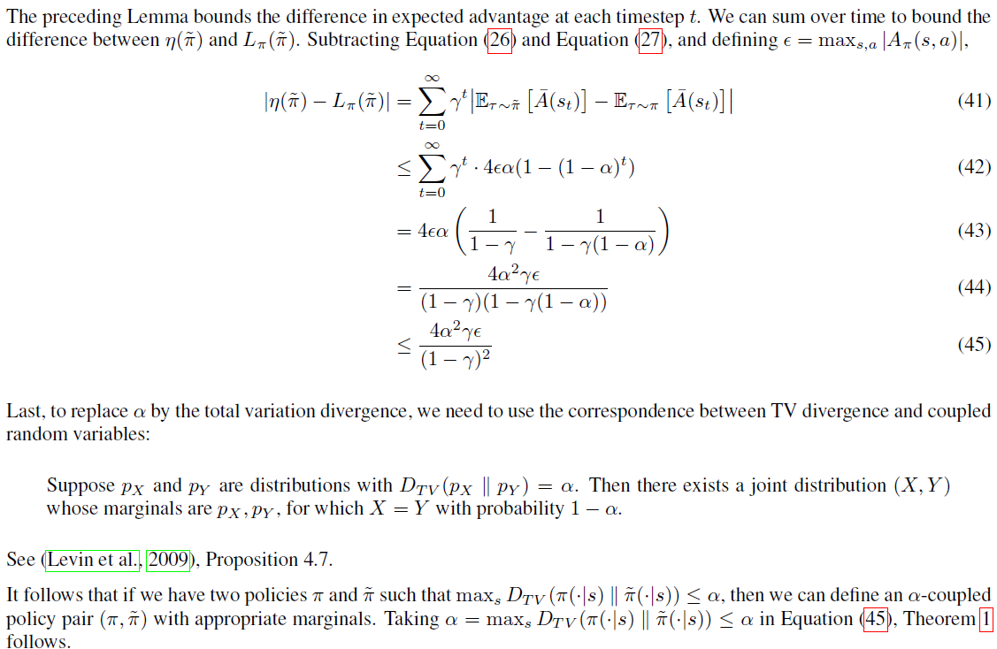
Appendix
[Proof of Theorem 1]

